Slide 1
Advanced Business
Communicating Design
With LoRa Communication Protocol

Slide 2


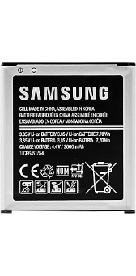


Candidates of Project Final Model
Fishing Boat
Whole
sale
Retail
Manufacturer
Wholesale
CPU’s BlockChain
Battery’s BlockChain
Disassembling Industry Model
Assembling Industry Model

Slide 3
Implemented Functions
Saving and Loading BlockChain
(Object Serialization)
Mining and Distributing Block
(Hash, Object Serialization, Socket Comm)
P2P Network
(Nodes IP Managing List, Thread)
Validating and Applying Received Block
(Hash, Object Serialization, Socket Comm)

Slide 4
Most Troublesome Problem
Some
State Change
(i.e. Network Comm, Reloading)
Block 123
(0x11111111)
Block 123
(0x11111111)
Block 123
(0xaaaaaaaa)
hashing(Object o) {…}
zxcvasdfqwer
poiulkjhmnbv

Slide 5
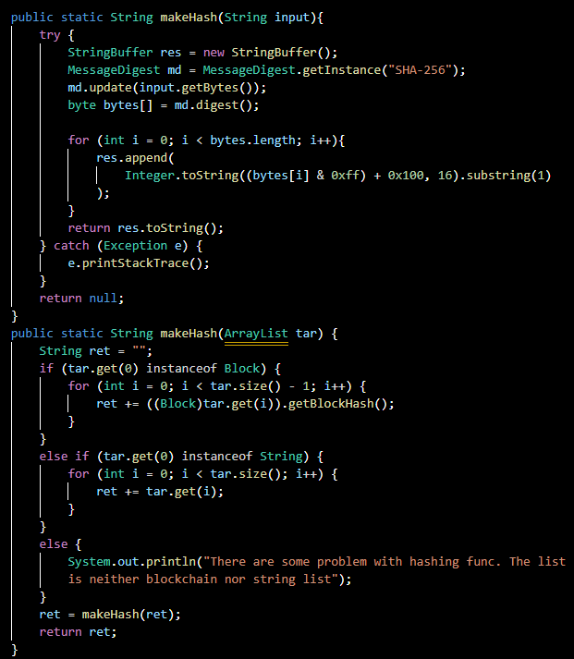
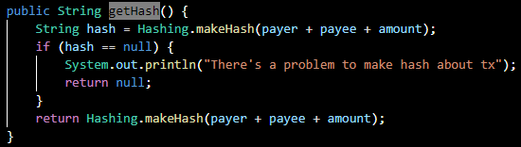
Element-wise Hashing
Environment-Independent Hash func
Func which makes TX’s Hash

Slide 6
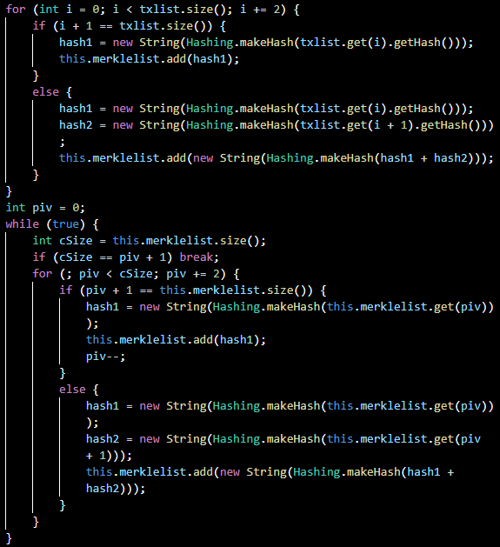
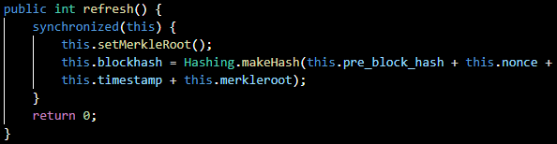
Element-wise Hashing
Make Merkle Tree
Re-Hashing Entire Block when TX added

Slide 7
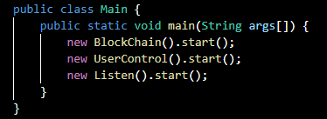
Main Functional Threads
BlockChain
For Initializing Mining, Distributing, Applying Block, etc
UserControl
For Scanning User Input (It may become a value reader)
Listen
For receiving the Other Node’s Request and Answer it

Slide 8
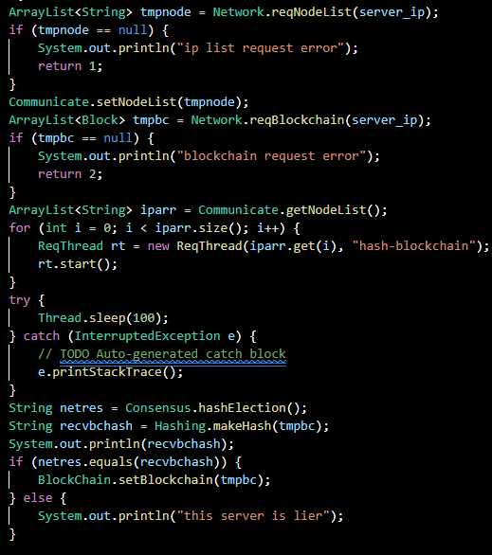
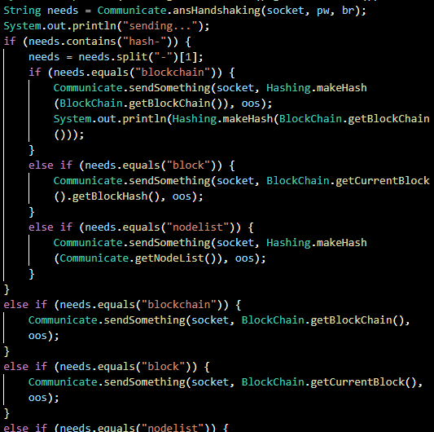
Codes for Initializing and Server
Request BlockChain and Validate

Slide 9
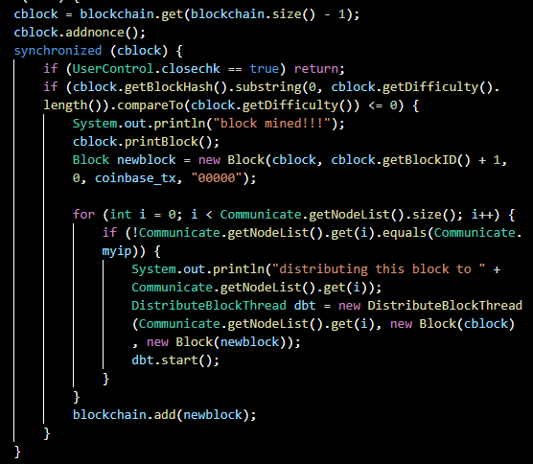
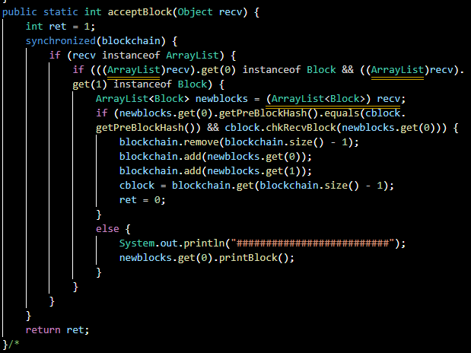
Codes for Mining and Distribution/Receiving
(with validation)

Slide 10
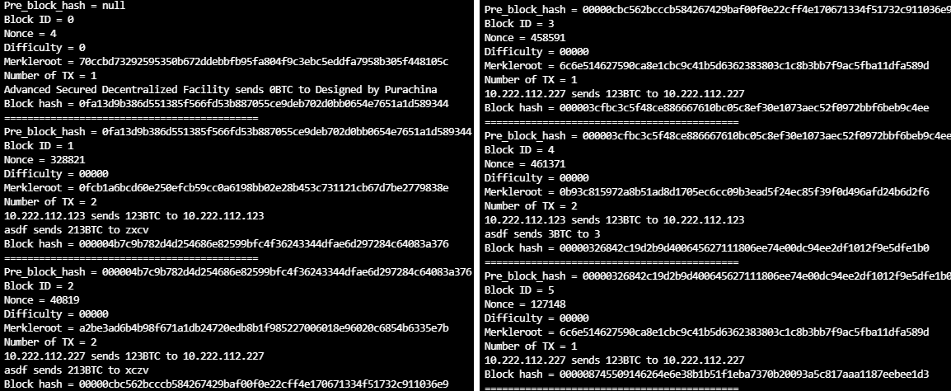
Operating Screen

Slide 11
Problems and Milestones
P2P Network with 3 or more Nodes
Because of Resource Sharing
Model Applying
How to Detail and Apply
Optimization
Separating Codes for Maintainability
Adding More Plausible Functions
Webpage for Introduction, Smart Contracts, More Consensus Algorithms

